Slide 1
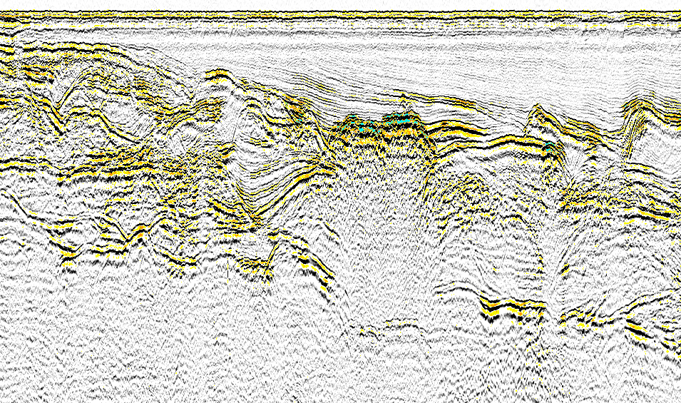
Stema Fluid mud solution
Stema Systems

Slide 2
Fluid mud
Influence on navigable depth and environment
Economic impact
Safety impact

Slide 3
Traditional echosounder survey

Slide 4
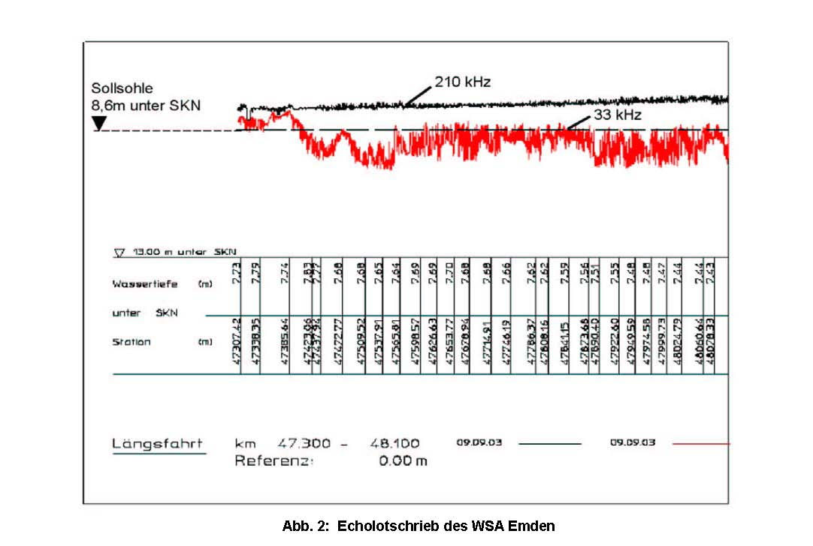
Dual Frequency Results

Slide 5
Highlights in Fluid mud
Notes:
Traditional system offer little to no information about material below the seabed

Slide 6
Stema Fluid mud solution

Slide 7
Combined solution
&
Low frequency

Slide 8
Tune Systems

Slide 9
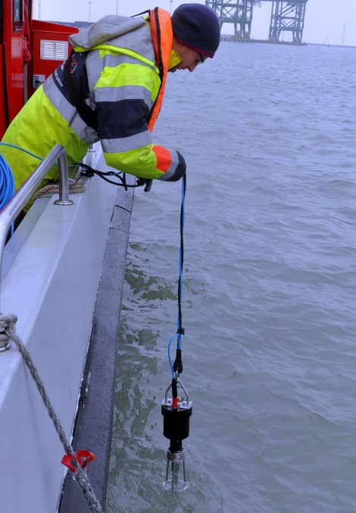
Tune Systems
Measures:
In-situ density
In-situ Yield stress
Depth (pressure)
Temperature
Inclination
Notes:
Based on vibrating fork principle
Relations:
density computed from fork resonance frequency
Yield stress from vibration amplitude
Alternative for radioactive source
Mechanical concept also provides information about
Strenght of material (yield stress, important for determination of nautical depth)

Slide 10
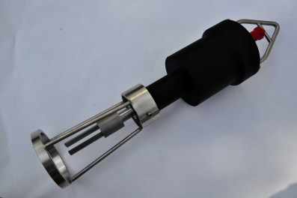
Tune Systems
RheoTune
Yieldstress
Density
Permanent use
DensiTune
Portable
Density
Portable use
Wifi functionality

Slide 11
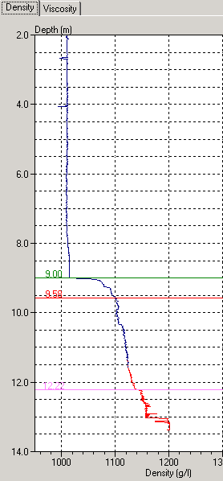
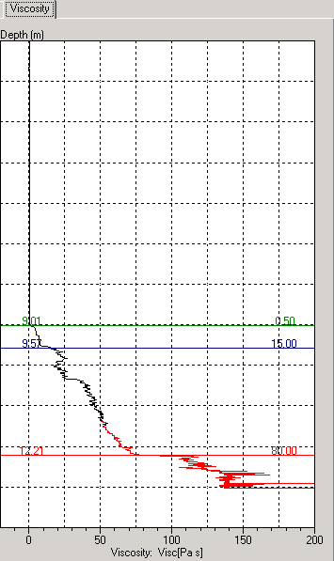
Tune Output

Slide 12
Silas Software

Slide 13
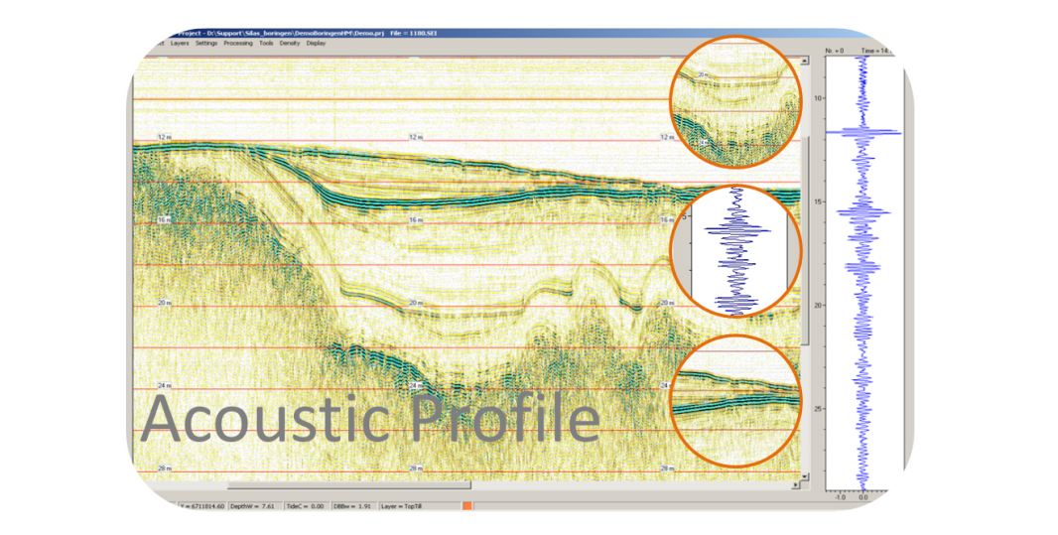
High resolution seismic
Low single frequency

Slide 14
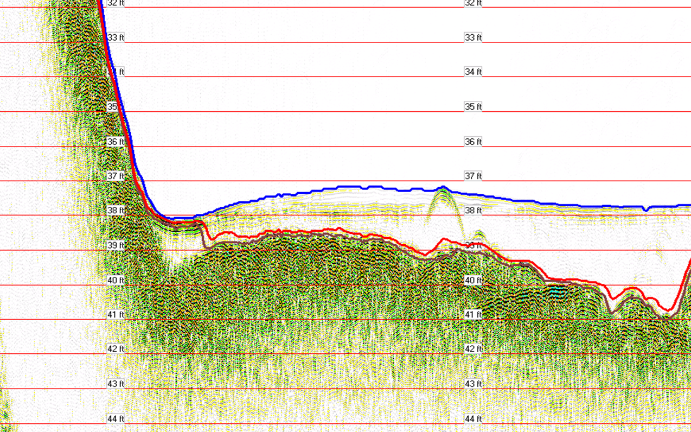
Silas Fluid mud example

Slide 15
Silas High resolution seismic
Results Silas:
Top of fluid mud clearly visible
Base of fluid mud layer with density < 1200 g./l. calculated after calibration with RheoTune
Yield strength of layer < 1200 g./l. : < 100 Pa
Notes:
Methods for nautical depth measurement in areas with fluid mud :
Singlebeam (20-40 kHz): A/D conversion and digitalisation of complete signal (e.g. Silas).
Characteristics:
-Consistency of digitalisation
-After calibration with RheoTune: Density and strength of material below level is known.

Slide 16
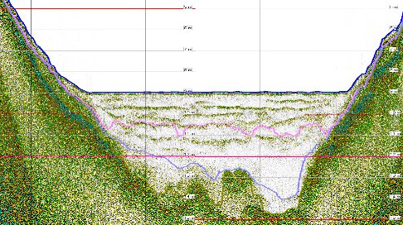
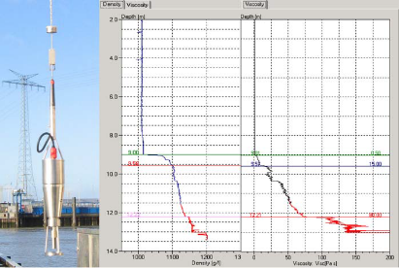
Final result
Acoustic profiling
Insertion probe

Slide 17
Stema Fluid-Mud Solution Users

